Slide 1
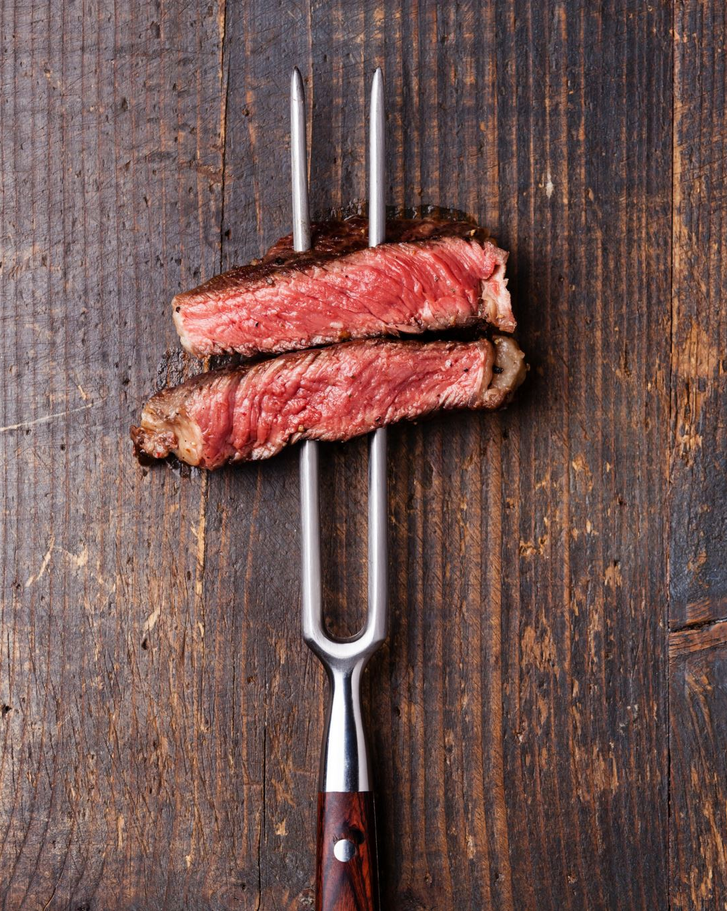
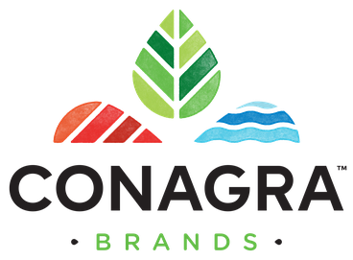
Unlocking Growth Potential in Conagra's Meat Substitutes Category: A Data-Driven Approach
Chukwunonso Nnodum

Slide 2
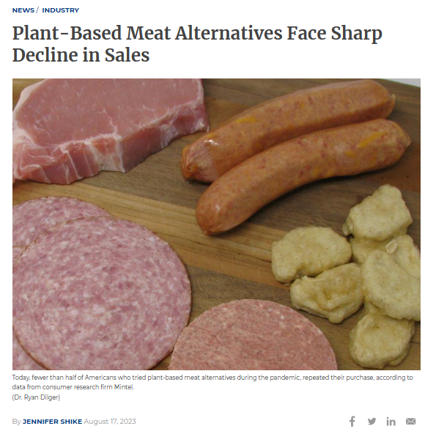
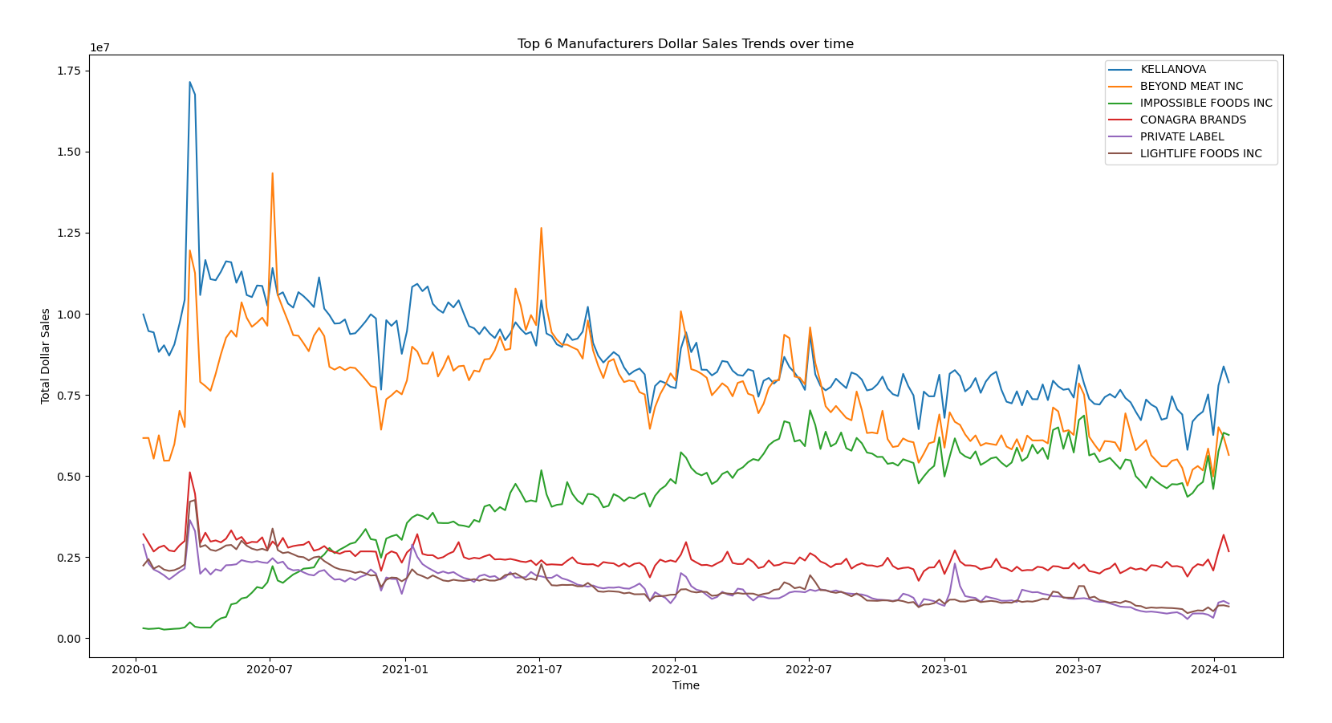
PROBLEM STATEMENT
The report from CoBank says that plant-based meat sales in the US are dropping because they're more expensive and not as tasty as regular meat.
Even though some people like them for health and environmental reasons, most folks aren't buying them again.
To get more customers, the industry needs to make plant-based meats cheaper and tastier, offer different types, and use better ingredients.

Slide 3
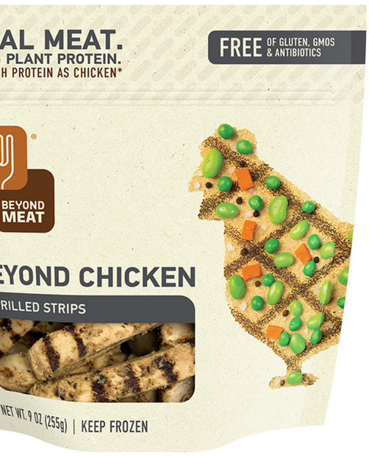
Project Description
Objective: Accelerate growth and optimize offerings within Conagra's Meat Substitutes category.
Conagra Brands is a leading American consumer packaged goods holding company. It operates under various brand names, offering products across supermarkets, restaurants, and food service establishments.
Meat Substitutes are plant-based or alternative protein products designed to mimic meat's taste, texture, and nutritional profile.

Slide 4
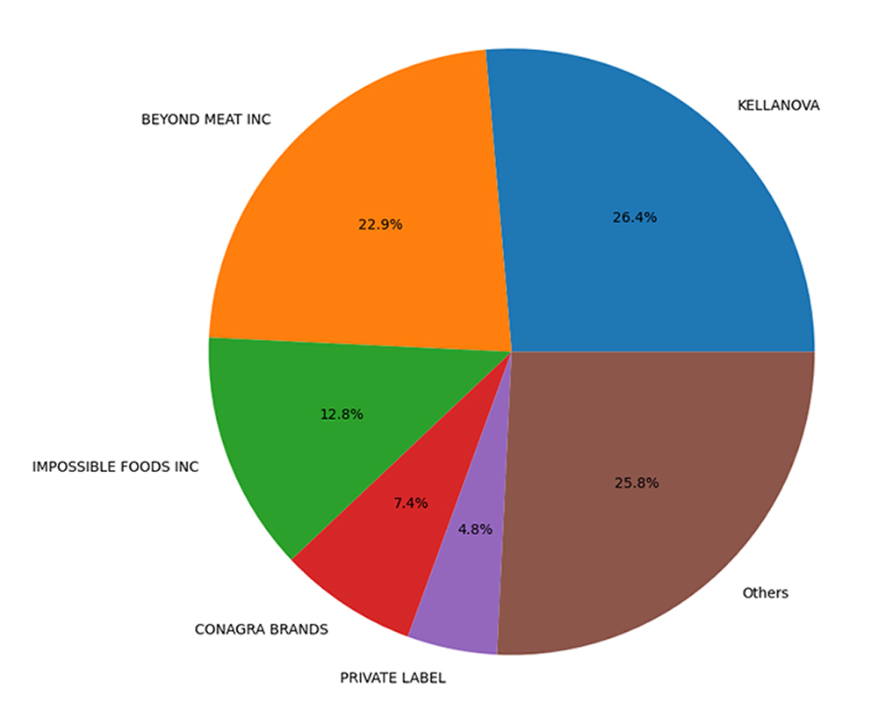
MARKET SHARE
We calculate the Manufacturers Market Share.
Manufacturers Total Sales
Market Share =
Total Sales
The top 5 manufacturers have around 75% of market share.
Kellanova
Beyond Meat INC
Impossible Foods Inc
Conagra Brands
Private Label

Slide 5
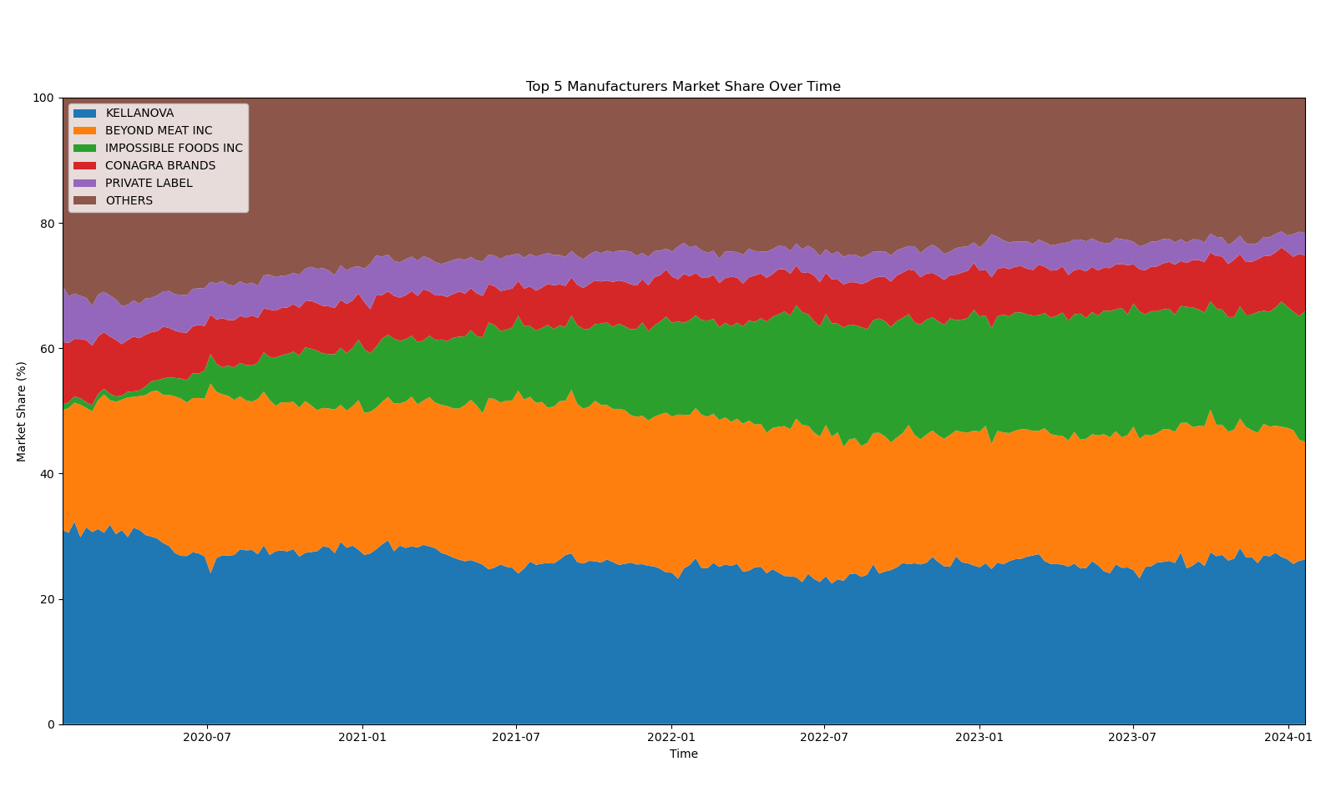
Trends in manufacture market share over time
The trend of Market Share for the top 5 manufacturers are almost constant over time. We can see some fluctuations, but they are negligible.
Market share of IMPOSSIBLE FOODS INC increase over time. In 2020, the market share was near zero, but by increasing the sales, in 2024, this manufacturer has the third market share for Meat Alternative products.

Slide 6
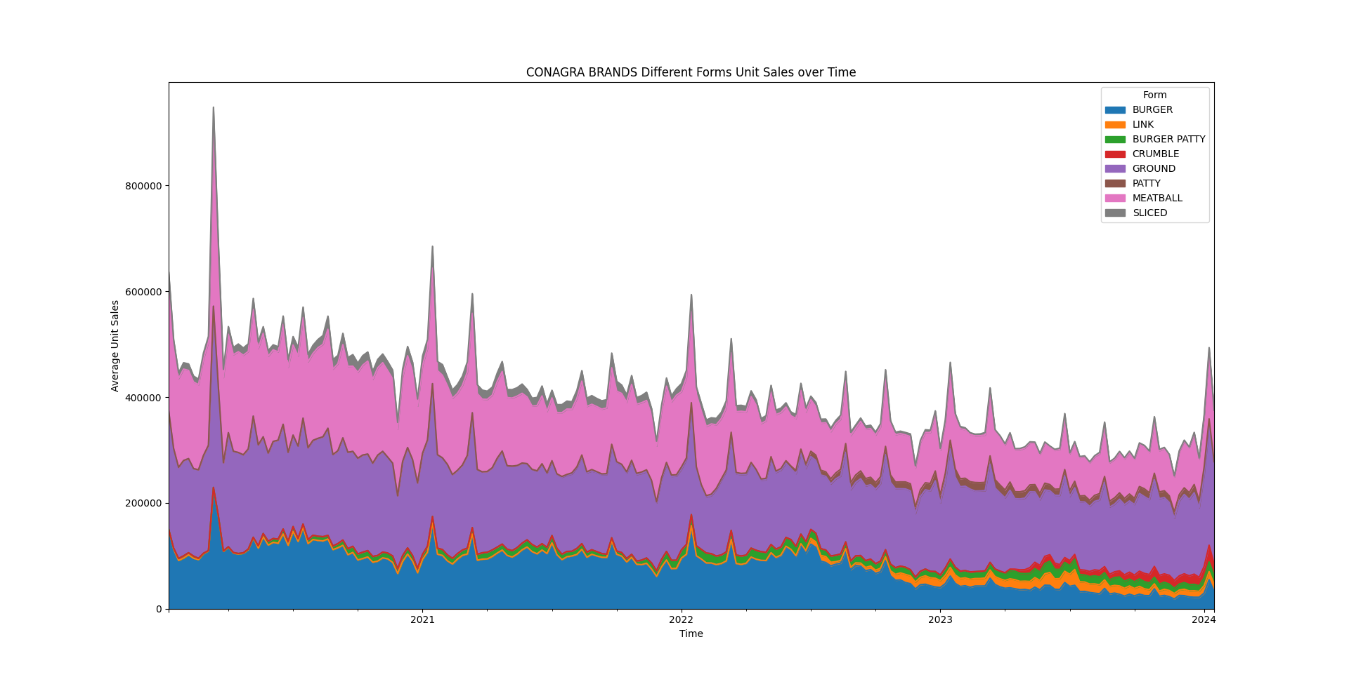
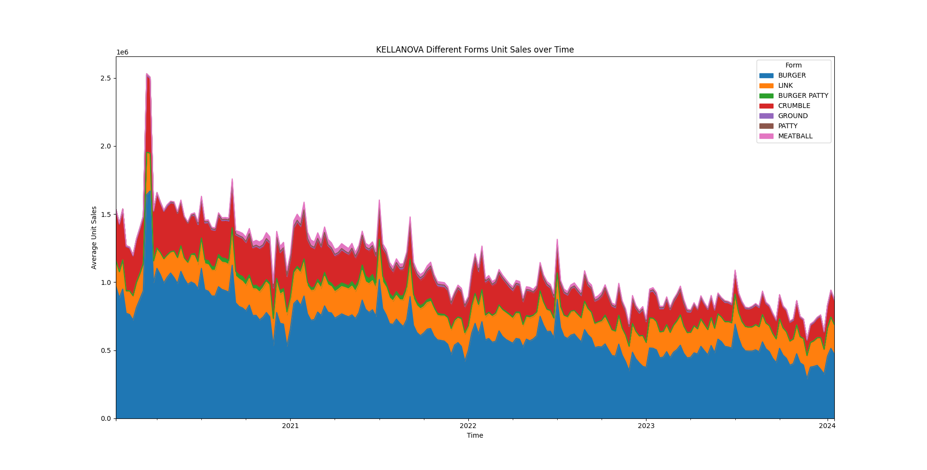
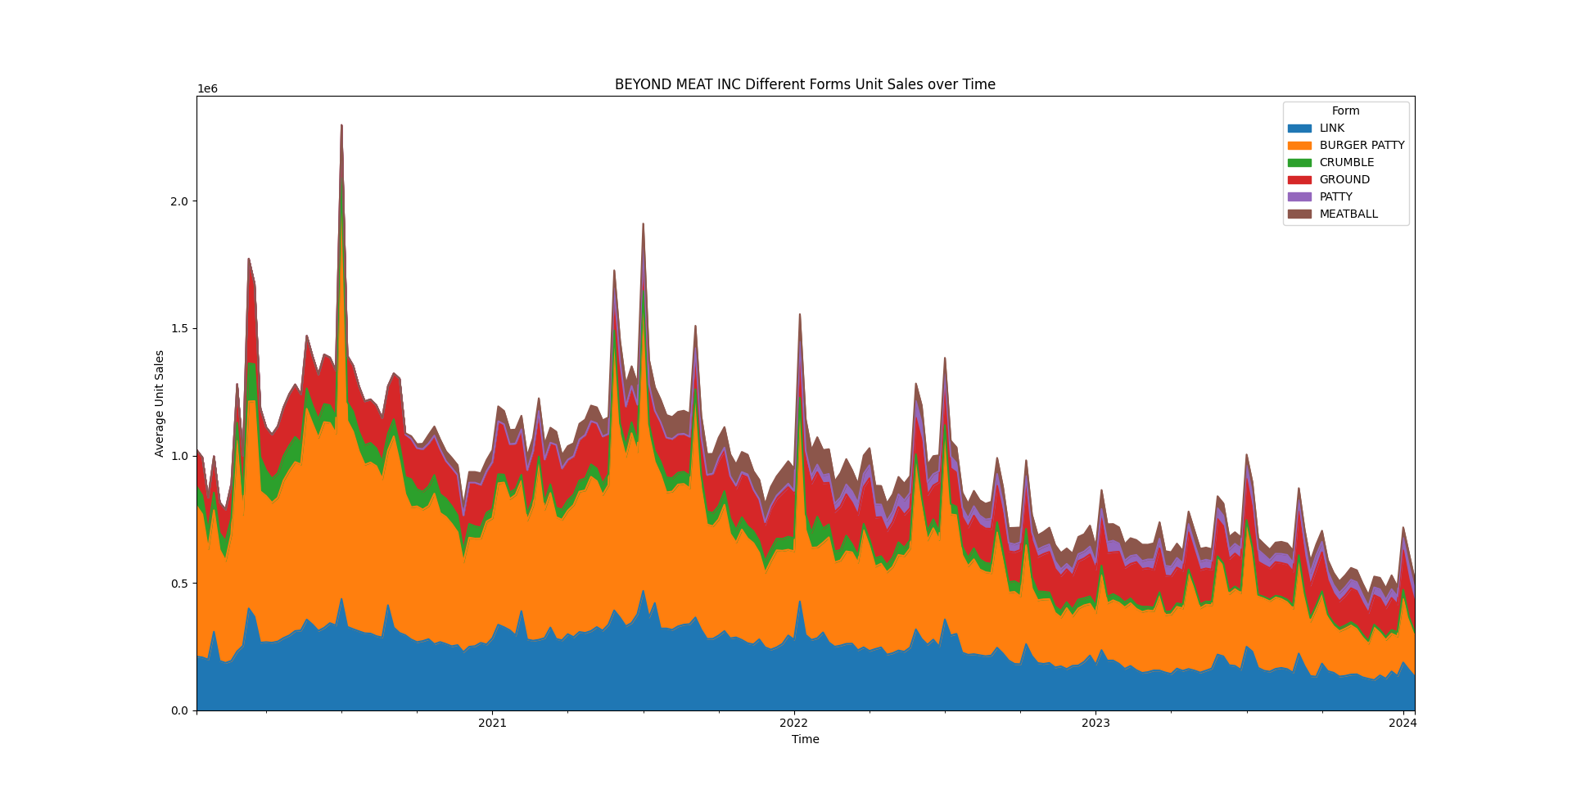
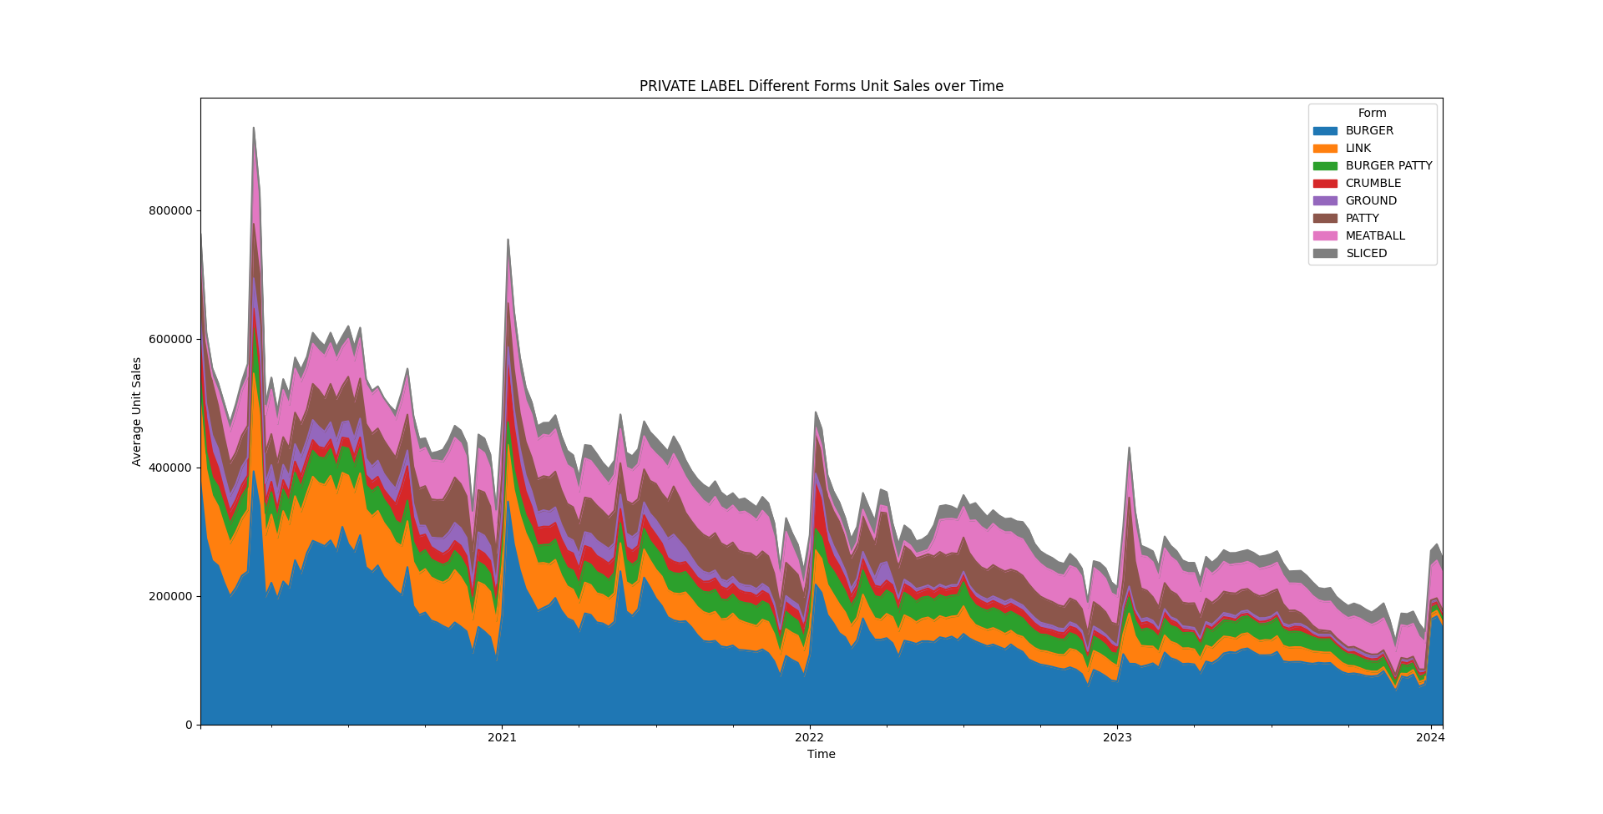
WHY IMPOSSIBLE FOODS INC HAS INCREASING TREND?
CONAGRA BRANDS
KELLANOVA
BEYOND MEAT INC
PRIVATE LABEL

Slide 7
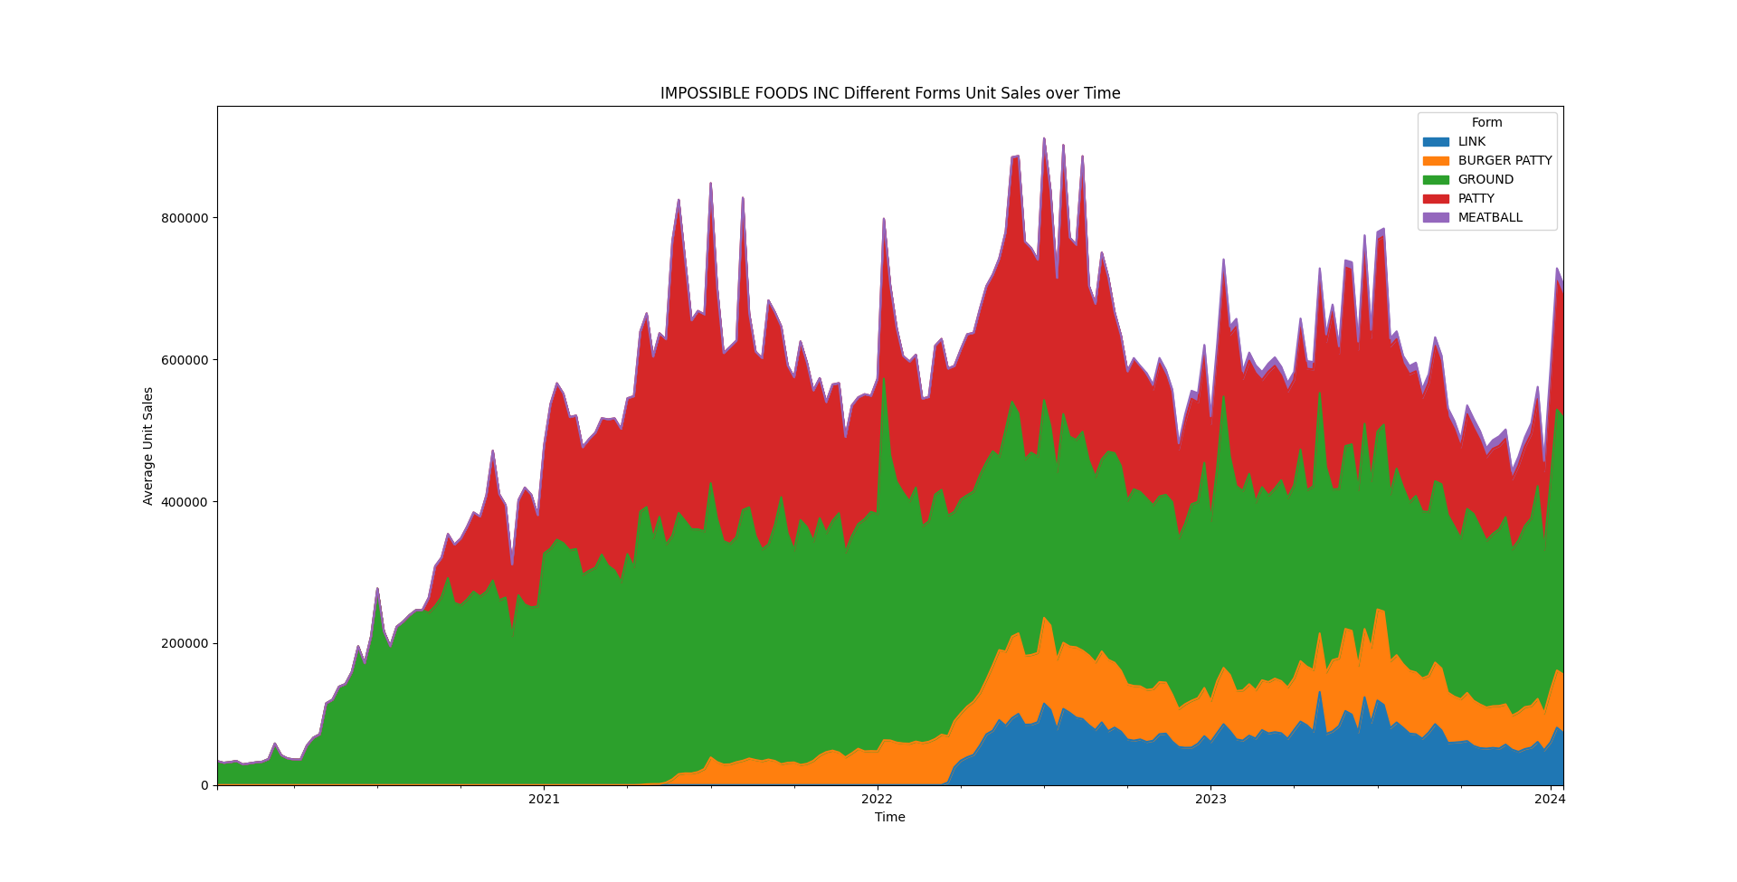
WHY IMPOSSIBLE FOODS INC HAS INCREASING TREND?
The IMPOSSIBLE FOODS INC manufacturer has added different forms of product over time to its line of production and increased the total sales by entering to the new markets.
This is a successful manufacturer among others due to the positive growth trend over the decreasing market period.

Slide 8
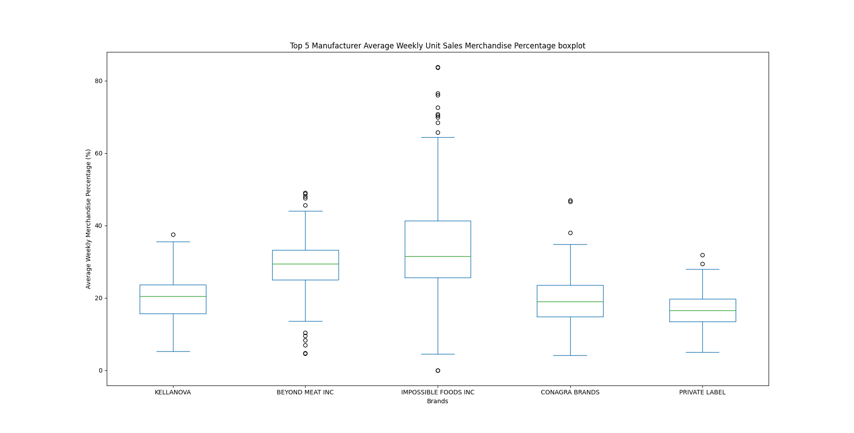
WHY IMPOSSIBLE FOODS INC HAS INCREASING TREND?
The IMPOSSIBLE FOODS INC manufacturer has the highest median for Merchandise sales percentage.
It means in 50% of time, the IMPOSSIBLE FOODS manufacturer sells around 35% of its products with merchandise. This number is the highest merchandise rate among other four big manufacturers.

Slide 9
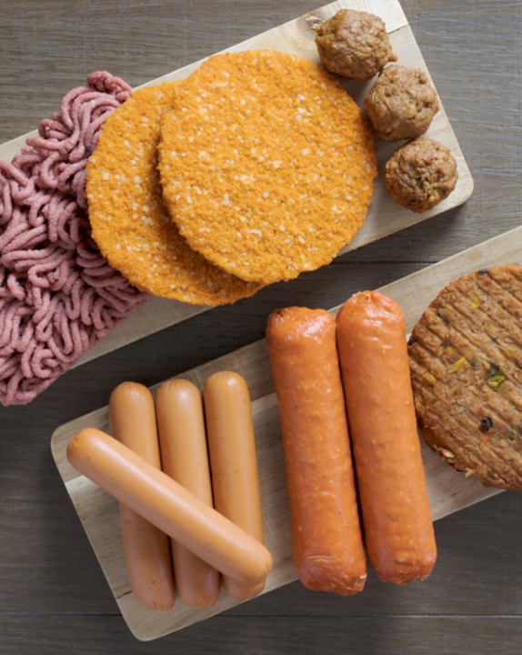
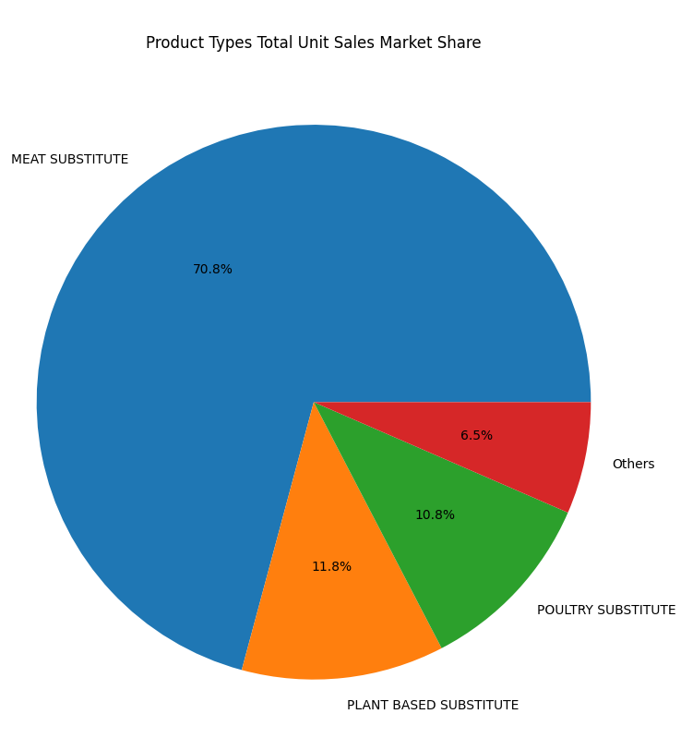
Meat alternative products and forms
There are over 18 unique product types for meat alternatives.
Meat Substitute constitutes above 70% of Meat alternatives markets.

Slide 10
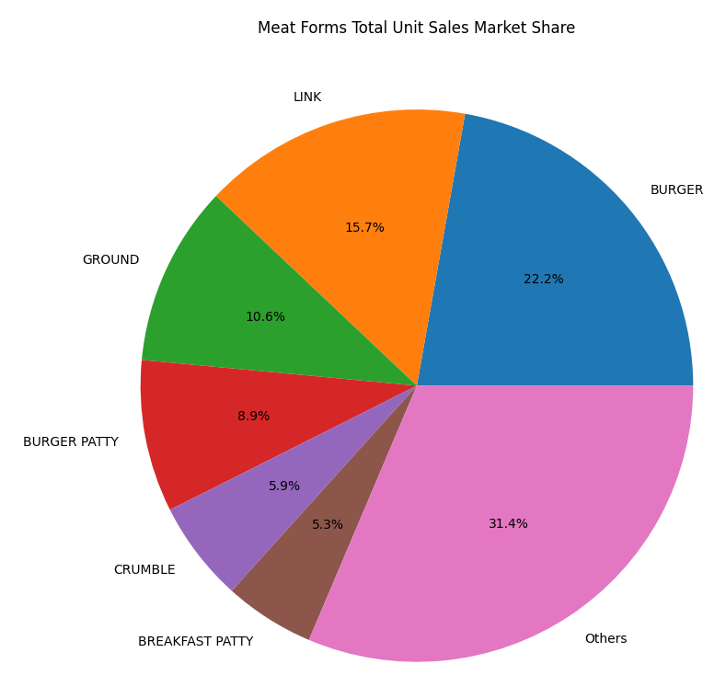
Meat Substitutes forms
There are over 55 unique meat forms in the dataset only for Meat Substitute product type..
Only 6 of them consist of around 70% of total unit sales for this market.
We focus on them Because they have a huge market and would be a great opportunity for a company to maximize its sales on them.
BURGER
LINK
GROUND
BURGER PATTY
CRUMBLE
BREAKFAST PATTY

Slide 11
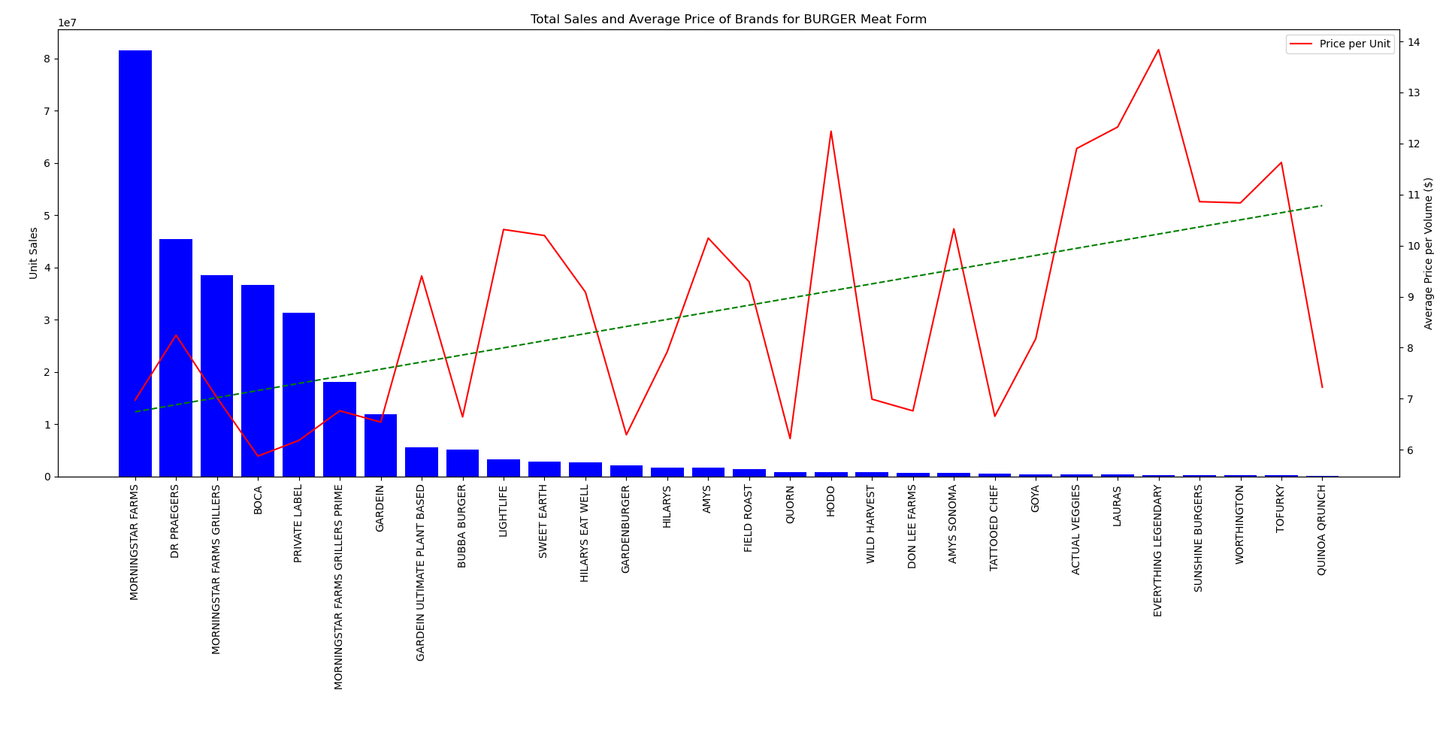
Substitutes forms market share
BURGER

Slide 12
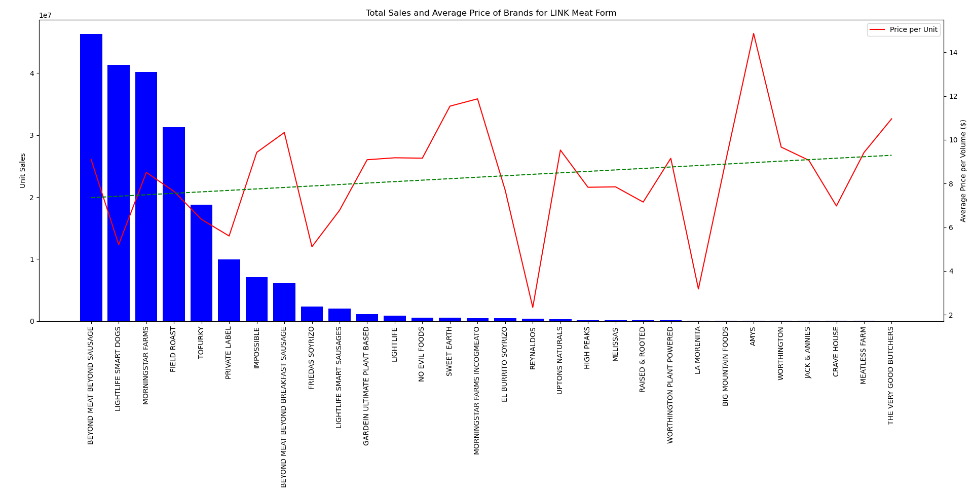
Substitutes forms market share
LINK

Slide 13
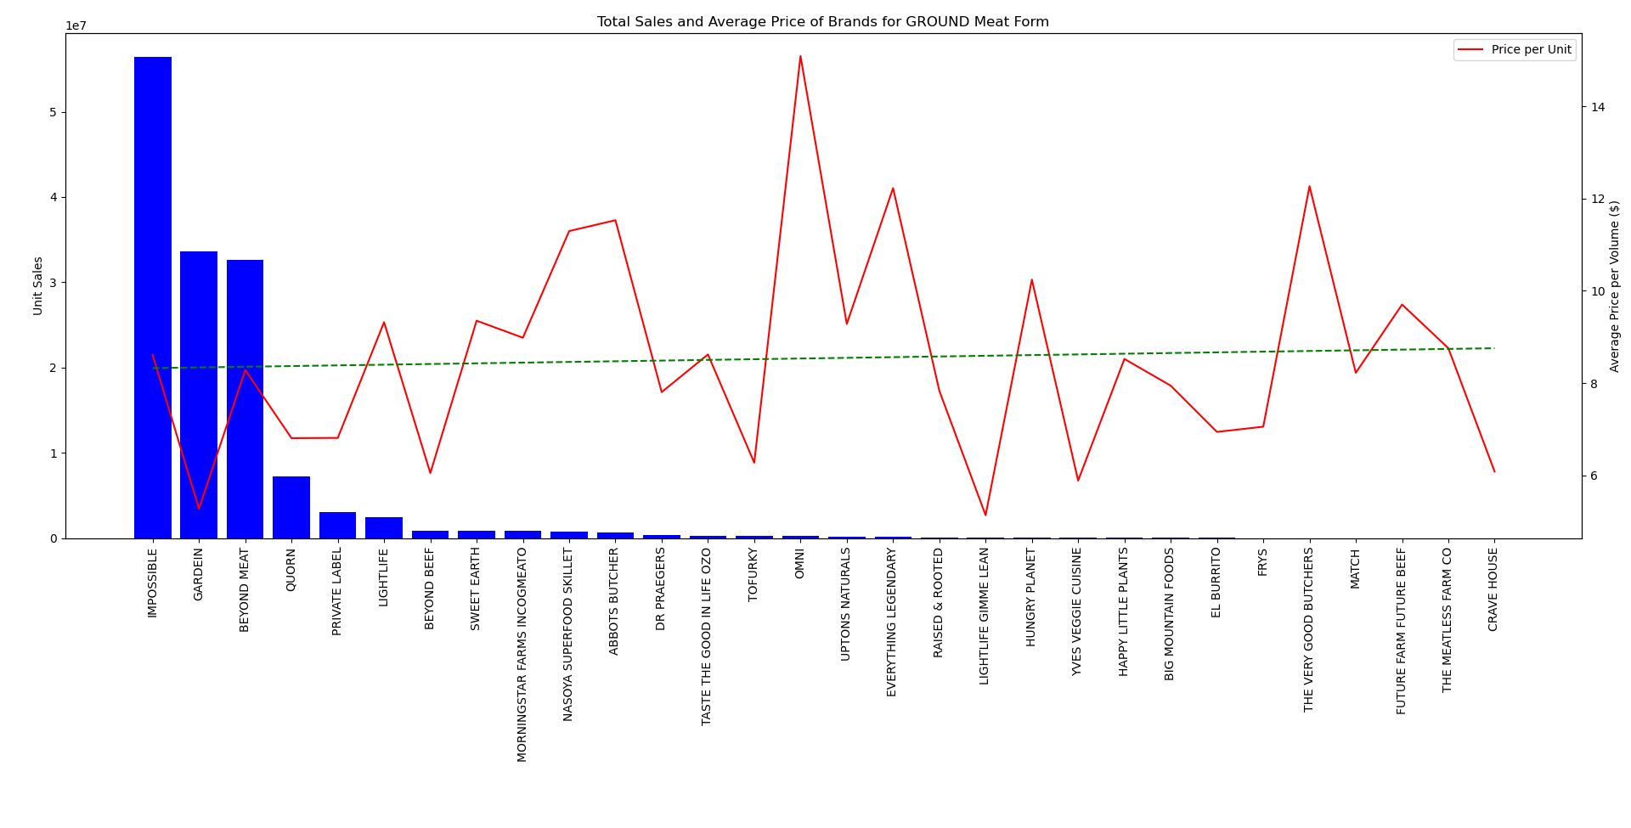
Substitutes forms market share
GROUND

Slide 14
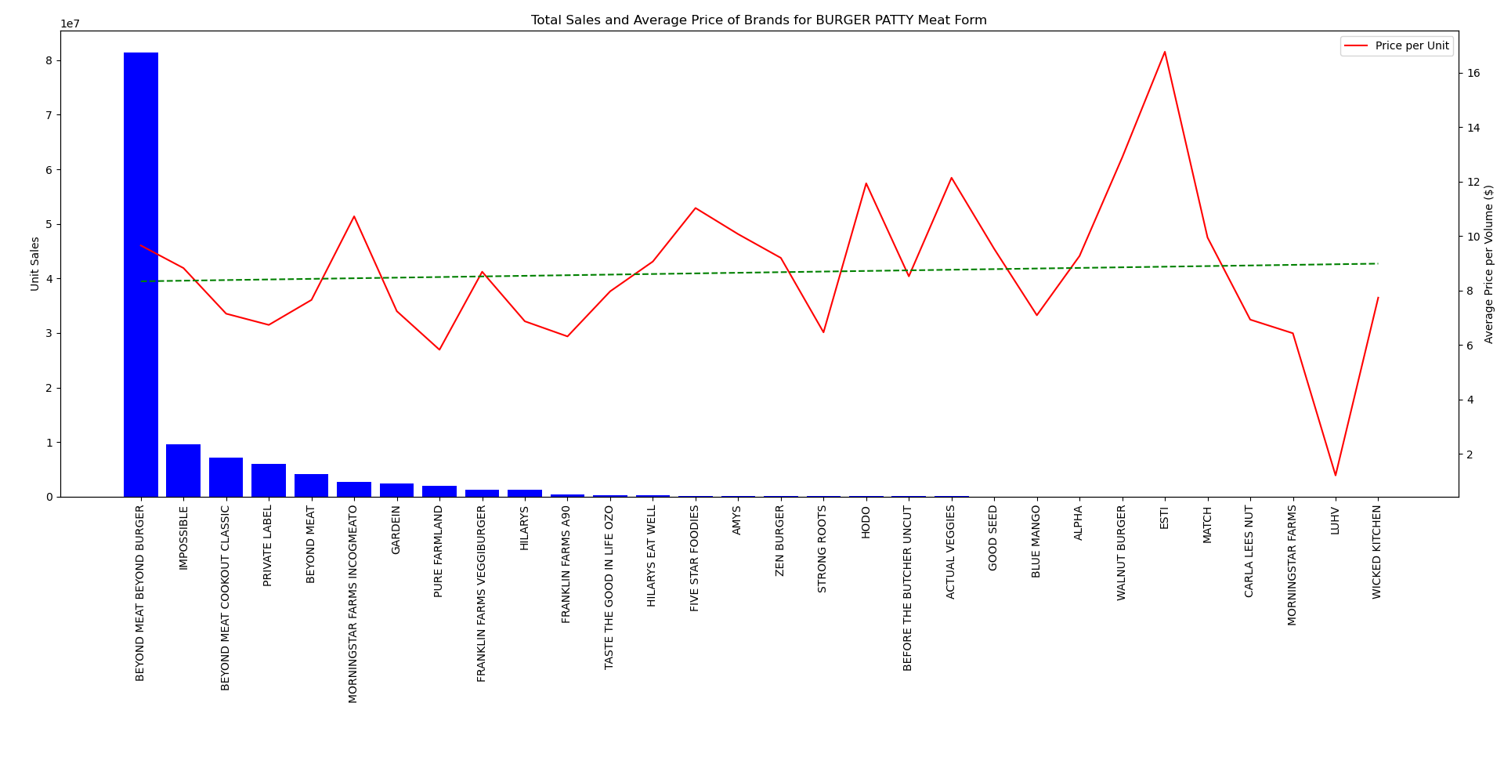
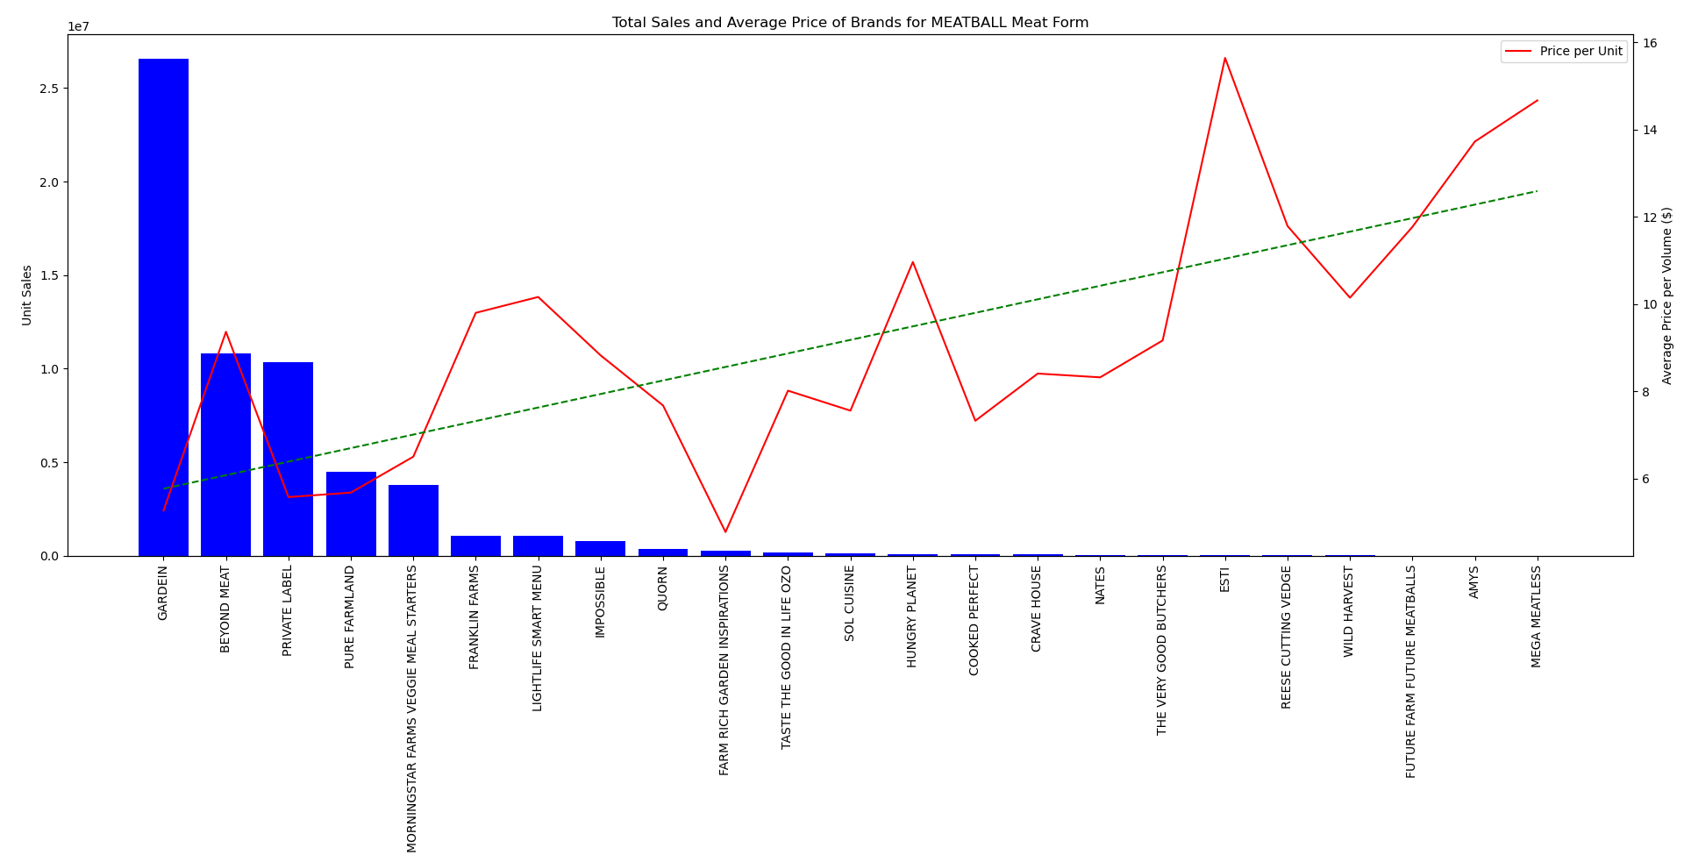
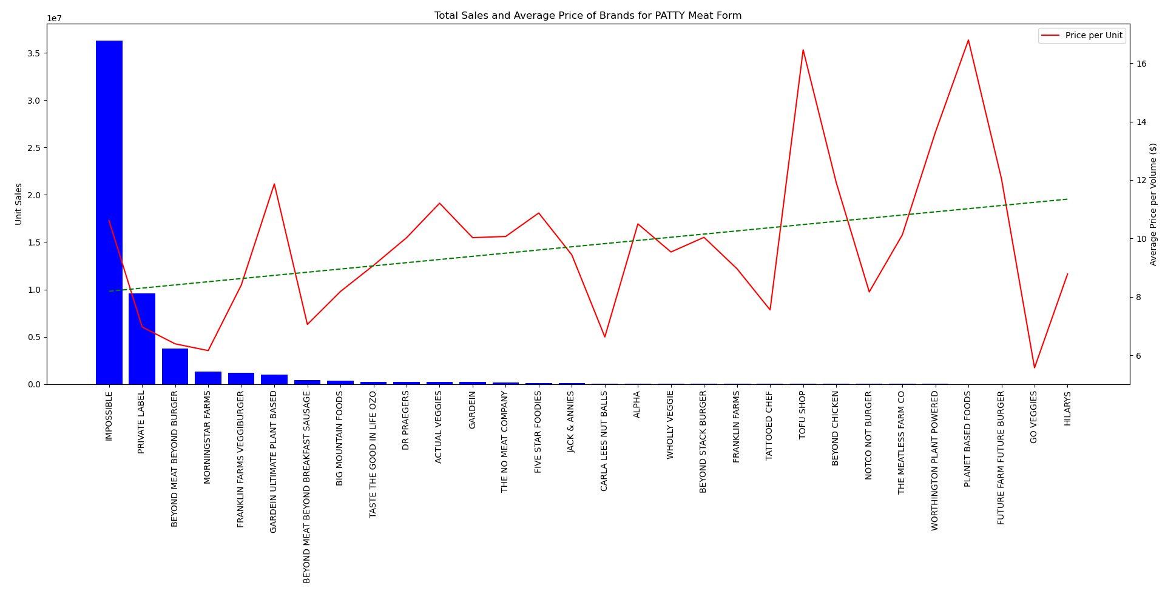
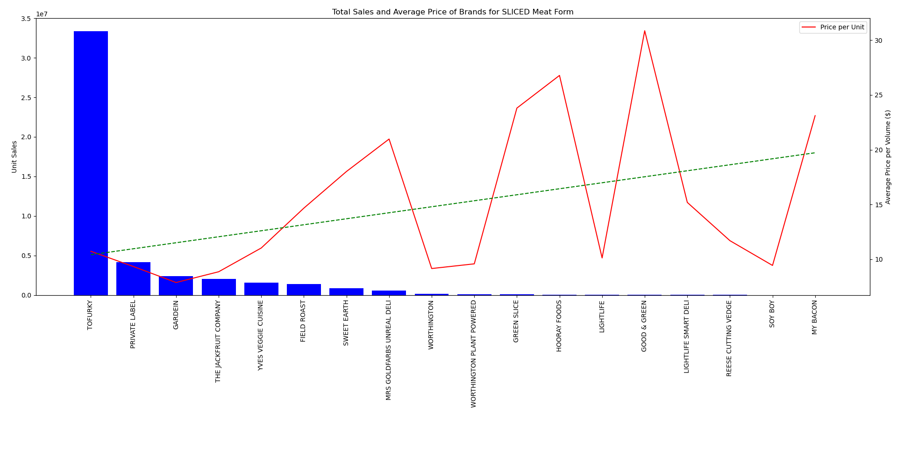
Meat forms sales price
For some substitute forms, there is only one or two main players in the market.
BURGER PATTY | MEATBALL
PATTY | SLICED

Slide 15
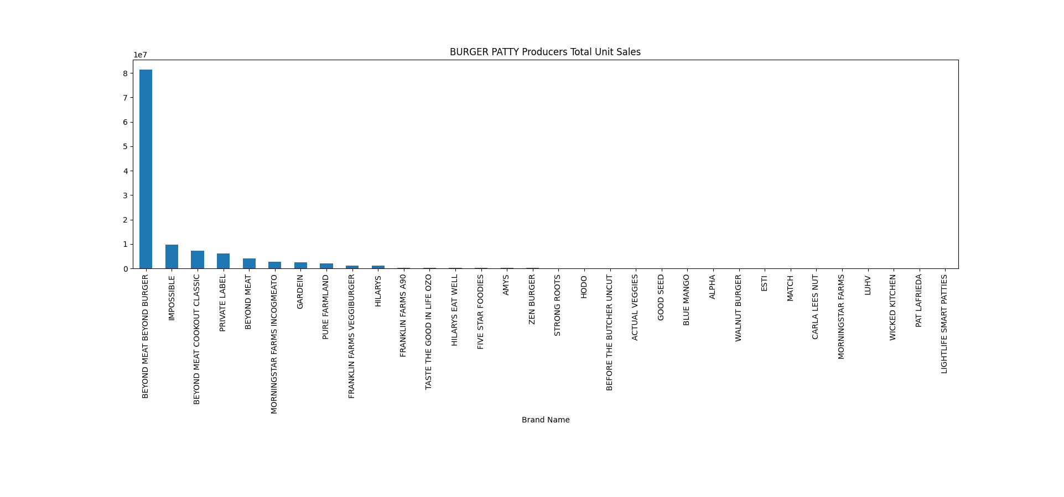
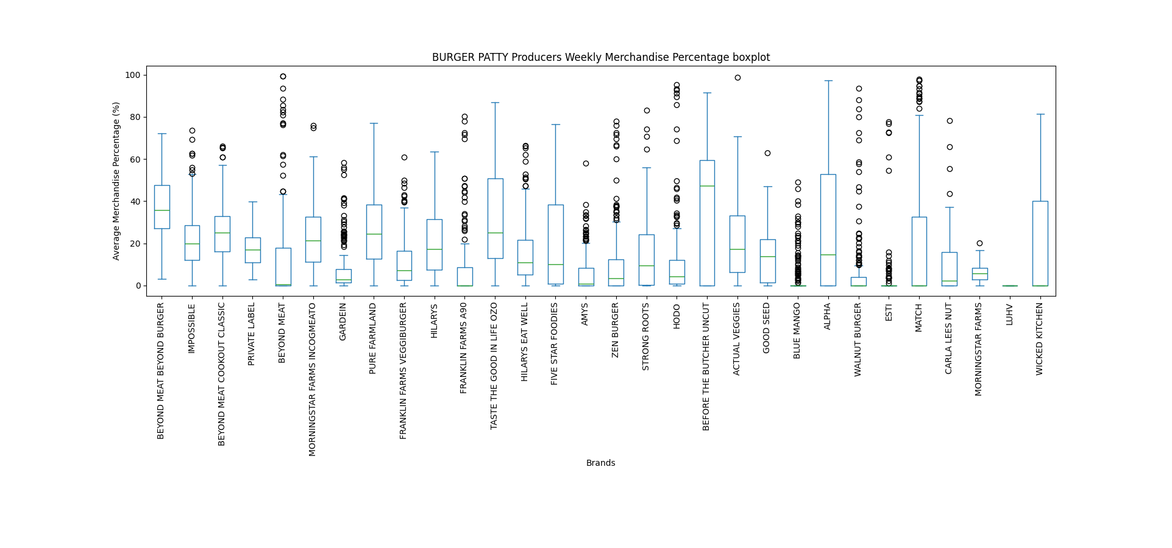
BURGER PATTY MAIN Players
Total Unit Sales with Merch
Merchandise Percentage =
Total Sales

Slide 16
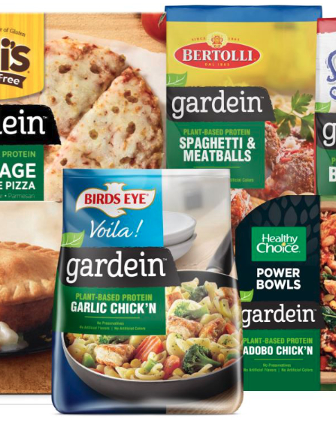
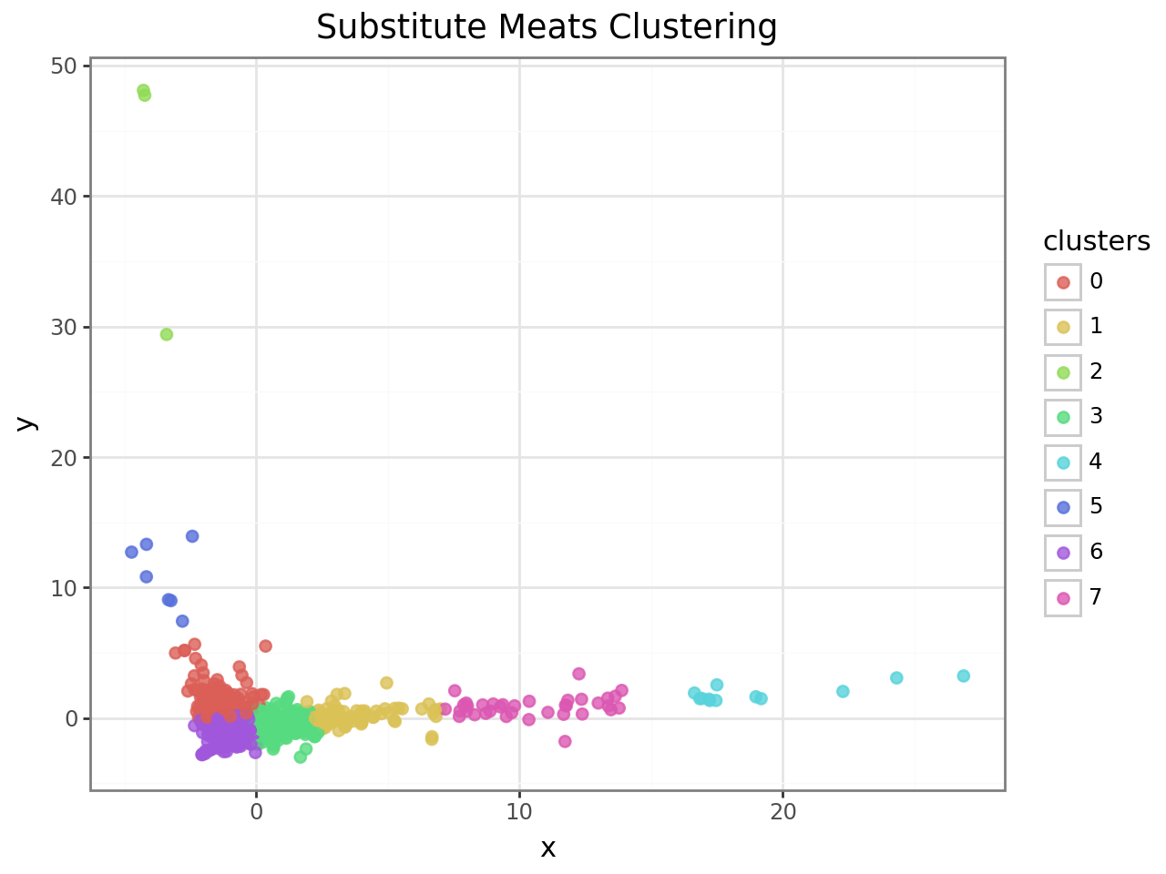
PRODUCTS CLUSTERING

Slide 17
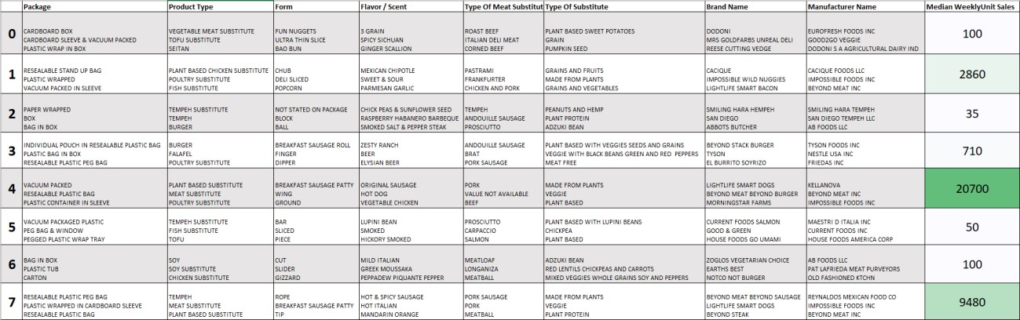
Products clusters

Slide 18
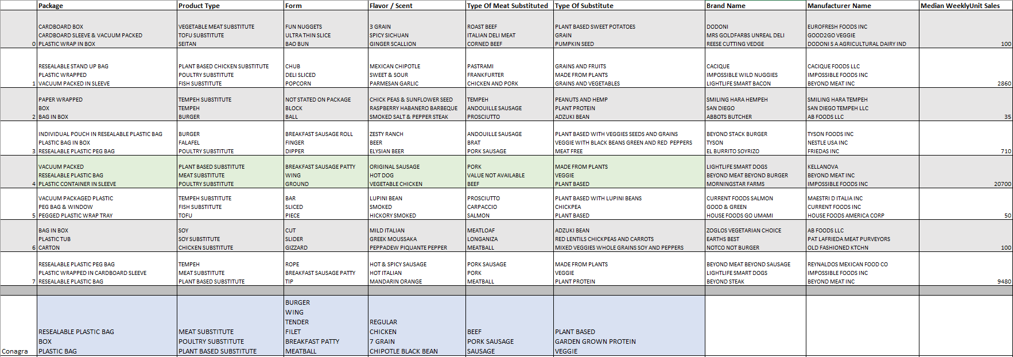
BEST clusters vs Conagra

Slide 19
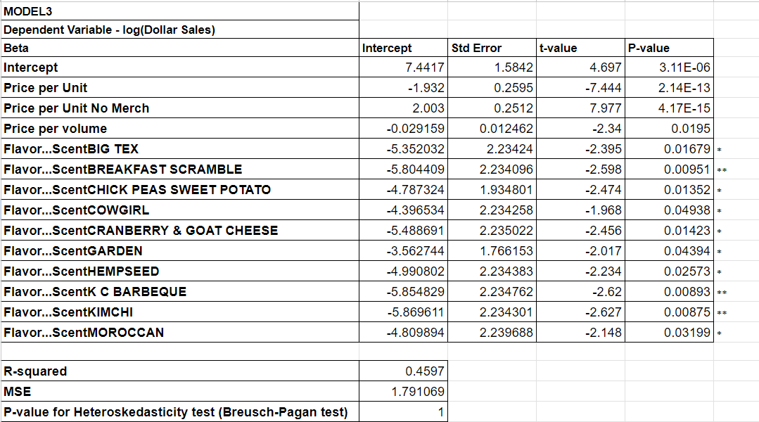
Regression model
The regression results show that the Flavor / Scent feature is a significant predictor of Dollar Sales

Slide 20
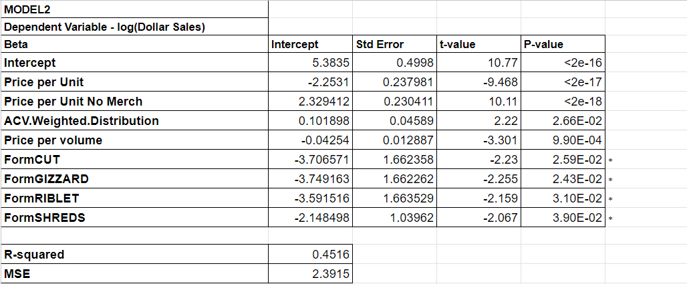
Regression model
The regression results show that the meat form feature is a significant predictor of Dollar Sales

Slide 21
Conclusion
Innovation and Expansion: By innovating new product offerings and expanding distribution channels, Conagra Brands aims to meet the evolving needs of consumers and capitalize on emerging opportunities.
Brand Awareness and Engagement: Building strong brand awareness through targeted marketing and branding efforts will be instrumental in driving consumer adoption and loyalty towards Conagra's meat substitutes.
Product Differentiation Matters: The type of substitute, meat substituted, flavors, scents, packaging, and form of the product all play significant roles in influencing Dollar Sales. This highlights the importance of product differentiation and offering a diverse range of options to cater to varying consumer preferences.
Consumer Preferences Drive Sales: The findings indicate that specific characteristics such as substitute type, meat substituted, flavor, scent, packaging, and form resonate differently with consumers, impacting their purchasing decisions. Understanding and aligning with these preferences are critical for driving sales growth.

